Slide 1


CS 590 Web Development - GROUP 15
ProFolio
Team Members:
Aditya Ramesh
Kavya Nandigam
Renee Suresh Manukonda
Sumedh Kumar Manoor Surendranath

Slide 2


So what’s ProFolio?
ProFolio is a web application that enables individuals to create visually appealing portfolios.
Users can seamlessly integrate their work, achievements, experiences, and skills, presenting a holistic view of their professional and personal journey to the world.
ProFolio helps users connect online, making it easier for talented individuals to find and work with potential partners, employers, or clients looking for their specific skills and experiences.

Slide 3

Who is benefited from
ProFolio?
Versatile Portfolio Platform for Professionals:
Empowering professionals across diverse sectors to showcase their expertise and accomplishments seamlessly.
Job Seeker's Career Launchpad:
A gateway for ambitious job aspirants to impress potential employers and secure dream opportunities.
Freelancer's Showcase of Skills:
Elevating freelancers by presenting their unique skills and talents to attract and engage potential clientele.
Student's Academic Spotlight:
A spotlight for students, illuminating academic excellence and extracurricular achievements.
Personal Achievement Chronicle:
Offering individuals a curated online space to elegantly exhibit life's remarkable milestones and accomplishments.

Slide 4

Features
User Registration:
User canstore user email and password securely, verify email addresses through confirmation links or codes and also has password recovery options.
Responsive Design: The platform is responsive and mobile-friendly and compatible with major web browsers and devices.
Sharing: Offers easy sharing options through unique URLs and social media. Must generate shareable previews or thumbnails for social media sharing.
Template Selection and Customization:
This application offers a variety of portfolio templates which allows users to choose templates and provides a preview option.
Social Media Integration: This platform will allow seamless integration with major social media networks, enabling users to link their portfolios to their social profiles, share portfolio updates, and engage with a wider audience across different social platforms.
Email Notifications:
It sends email notifications for account-related activities and promotions.

Slide 5











Our choice of weapons?

Slide 6
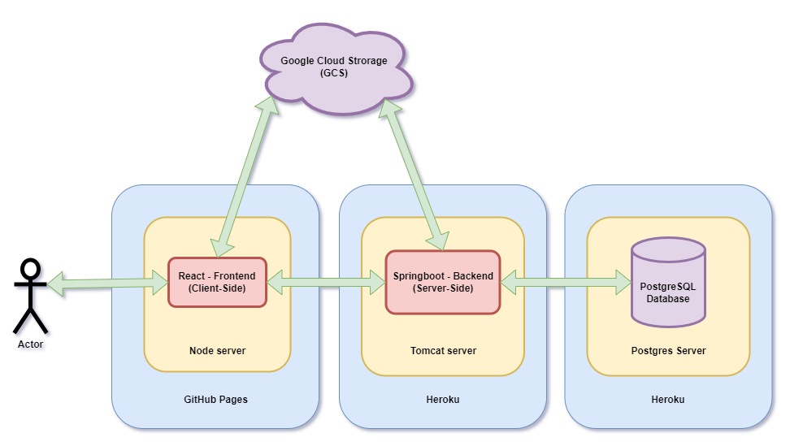
System Architecture

Slide 7

LET’S SEE THE DEMO ALREADY??
Let’s Go!

